Slide 1
An activity model for exposure assessment
Meng Lu

Slide 2
Goal:
An agent-based exposure assessment model for situations…
1) that we don’t know the activity schedules and activity locations of each individual,
2) but we have basic information of e.g. all the University locations, functional buildings,
3) and we can assume or derive from activity data (e.g. surveys/literatures/ GPS tracks) the probability distributions of the departure times of activities, travel means, and destination locations, for different population group e.g. school students, old people, half-time worker…

Slide 3
So far:
Probabilistic identification of possible destination locations for each activity.
Probabilistic sampling of a travel means based on distances
Probabilistic sampling of the departure/starting times of activities

Slide 4
Model overview
Input
Location to estimate (e.g. home location)
All the possible locations for each activities (e.g. University, shops, all the functional buildings).
Activity profile (e.g. students)
Optional: activity surveys
ABM model
Three types of activities:
1) Staying at the front- door location
2) Commuting to a destination
3) Buffer-ed zone or random walk over the original location.
Output
Activity schedule:
ID, Start time, end time, activity
Geospatial geometries:
points (e.g. front door),
lines (e.g. routes), or
polygons (e.g. buffer)
Model parameters
e.g.
maximum travel distance for different population group and activities
Relationships between transportation means and distances
from a default function/value, or from activity surveys, literatures

Slide 5
Procedure for modelling commuting to a destination
Sample a destination
for each activity based on a maximum travel distance.
2. Choose a transportation mean
based on the travel distance
3. Query routes
from road (OSM) map to the destination
4. Generate schedule
according to the travel time and activities

Slide 6
Study case
Model parameters are determined using the Ovin Dutch activity survey:
0.3% Dutch population

Slide 7
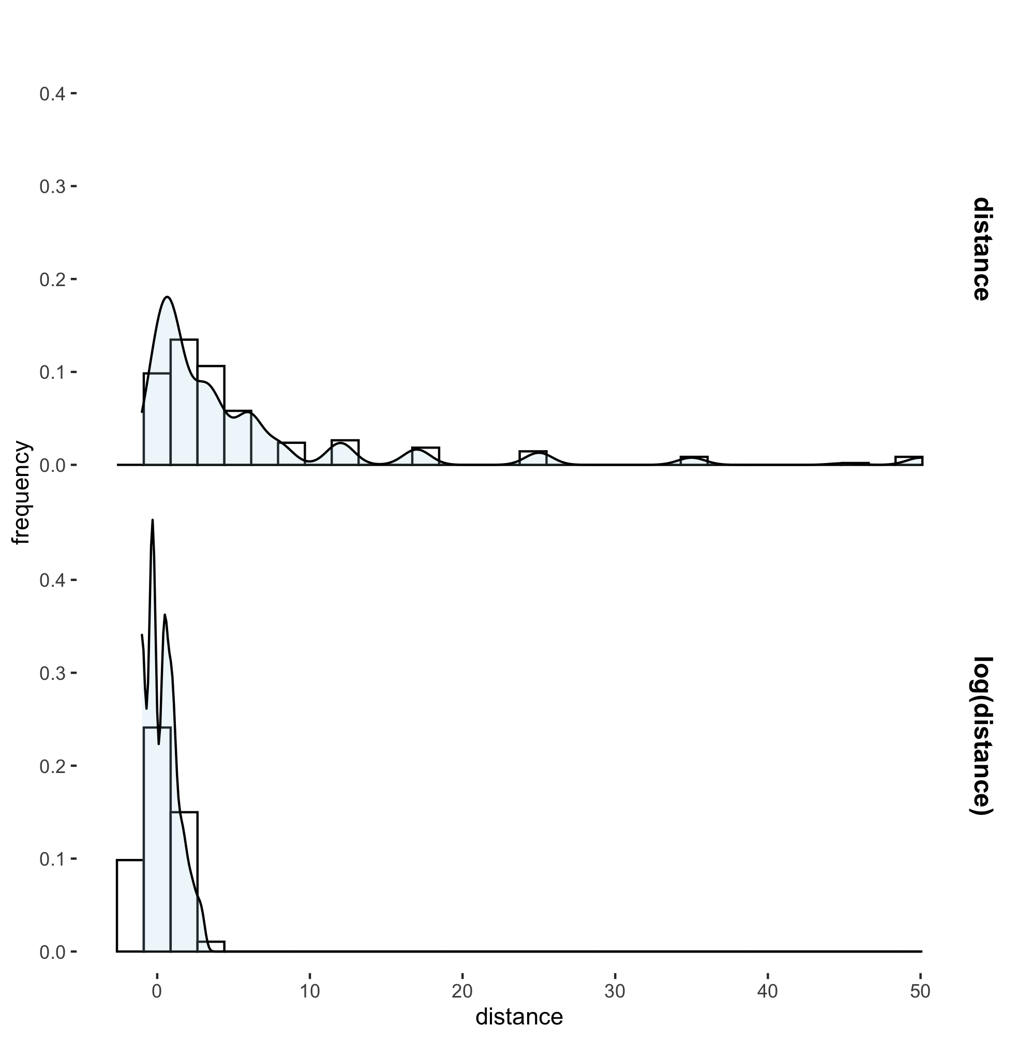
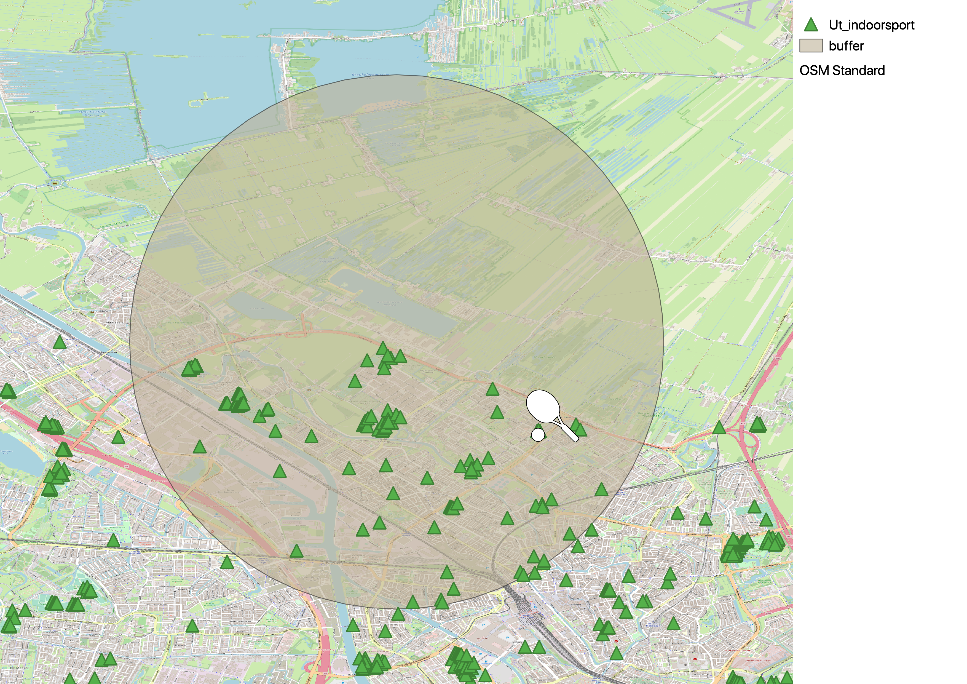
Sample a destination
Characterise the distribution of travel distances
Select candidate destinations and sample one

Slide 8
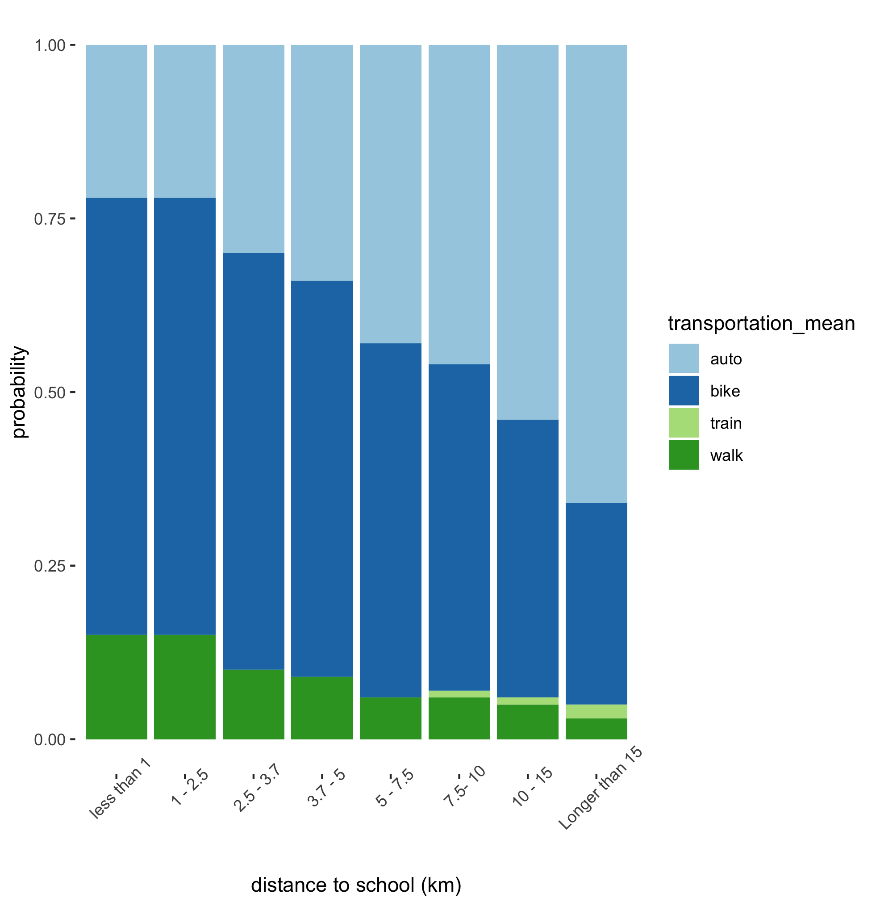
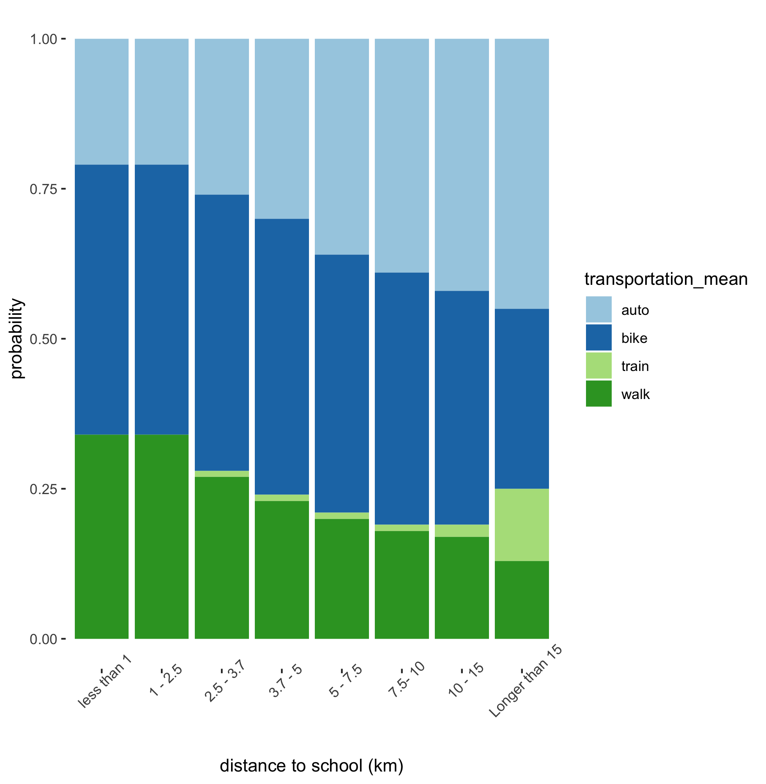
2. Choose a transportation mean: based on the travel distance
Student going to school
Half-time worker going to work

Slide 9
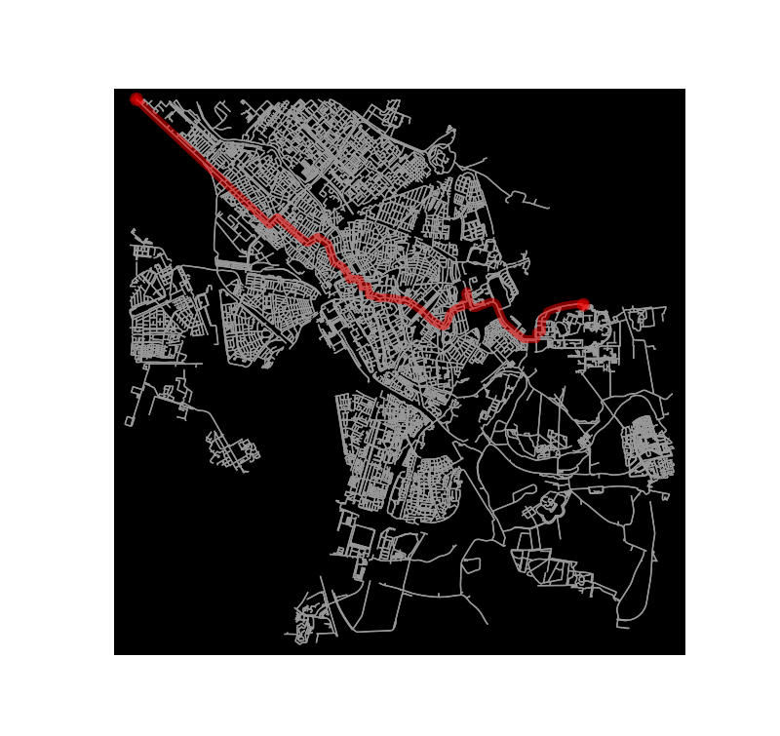
3. Query routes: from road (OSM) map to the destination.
By bike
By car

Slide 10
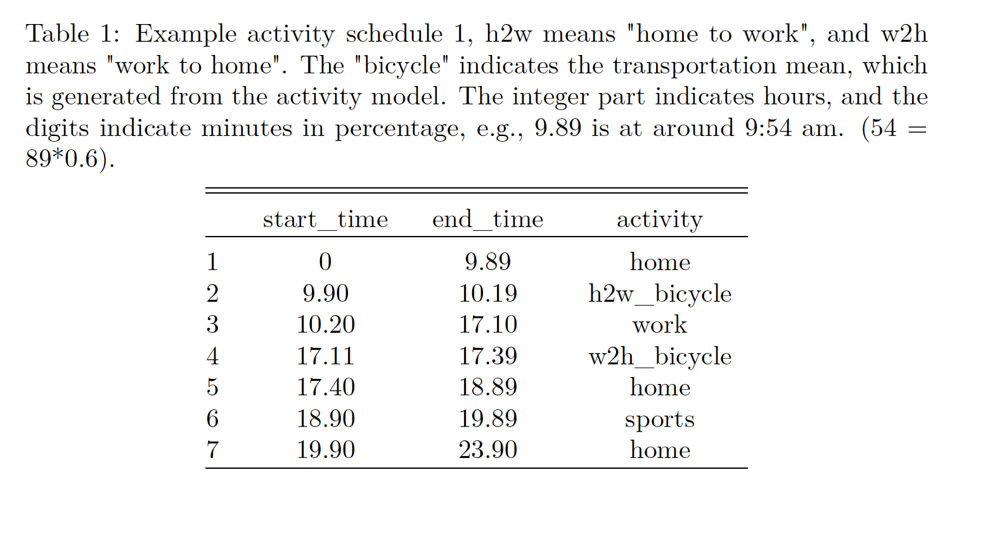
4. Generate schedule
Generate schedule

Slide 11
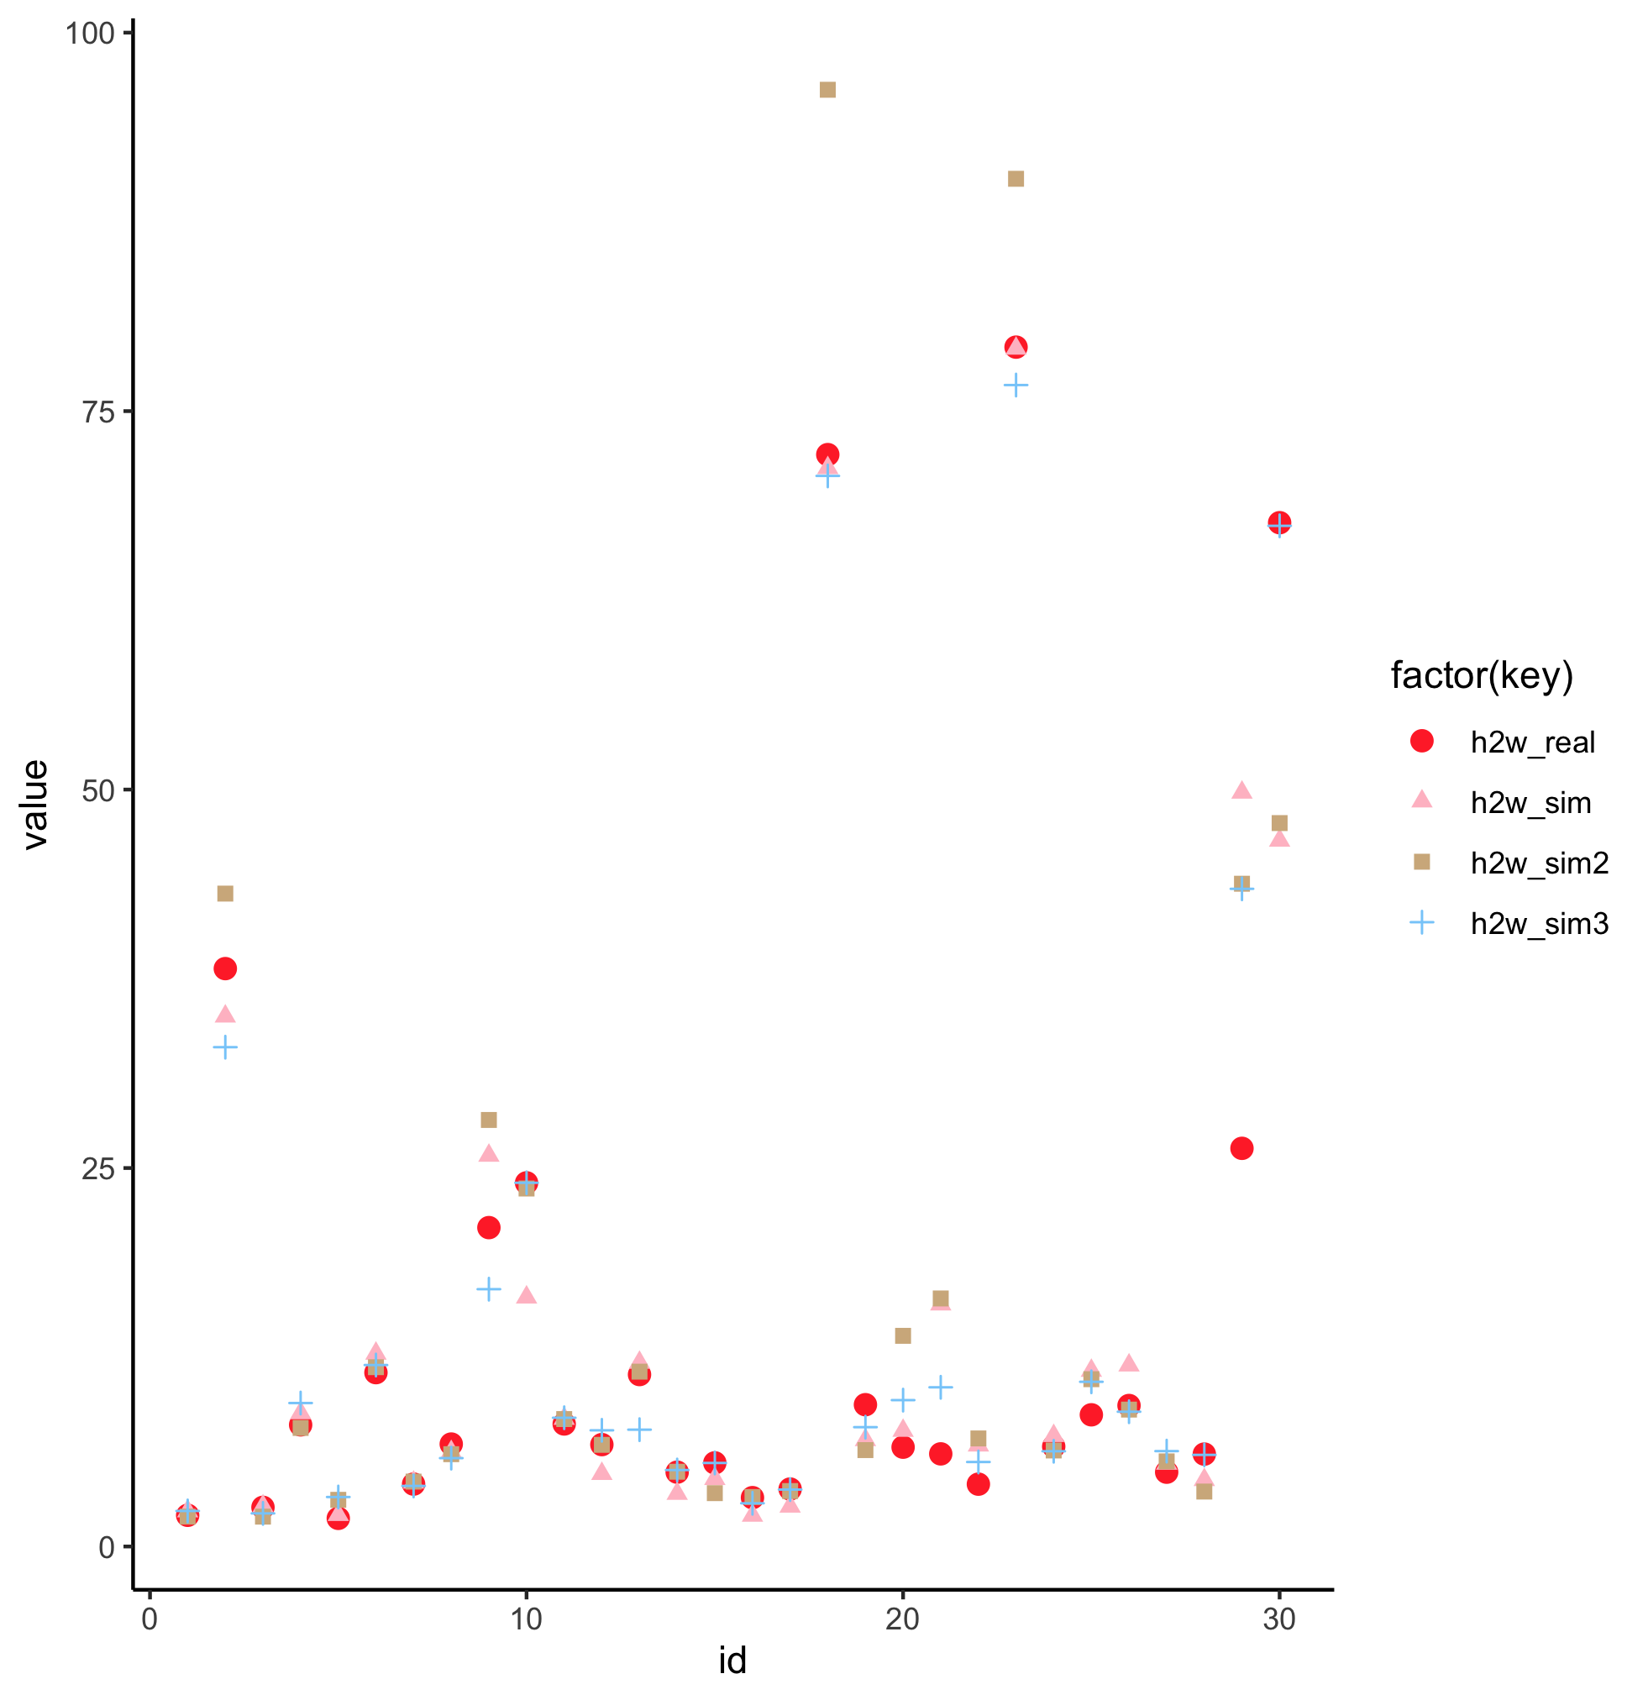
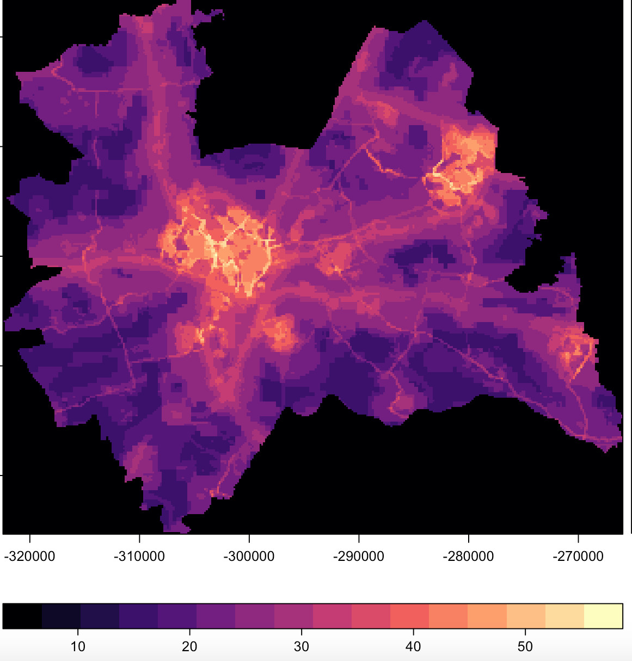
Results:
NO2 exposure assessed over commuting routes with simulated destination locations vs. real locations, for 30 home locations.
Activity schedule + spatial geometries (locations, path)
+ (annual) hourly air quality map
Multiple runs
Hourly NO2
24 hours

Slide 12
Next:
Adding geospatial variables (e.g. population maps, urban/rural land cover classification) for refined activity schedules. For example the distance distributions can be identified separately for residences living in rural and urban areas.

Slide 13
Feedback:
1, population groups are important
2, select location based on distance distribution? But if we select location purely based on distance that would be too time consuming.
3, sample routes as well, e.g. shortest distance, shortest travel time. Maybe useful for cars.

